Slide 1
Cluster Analysis

Slide 2
Week : Cluster Analysis
1 | Market Basket Analysis
2 | K means clustering
3 | Case study: 1
4 | Case study: 2

Slide 3
Introduction To Unsupervised Learning

Slide 4
Unsupervised Learning
Unsupervised Learning is a machine learning technique in which the users do not need to supervise the model.
Instead, it allows the model to work on its own to discover patterns and information that was previously undetected. It mainly deals with the unlabelled data.

Slide 5
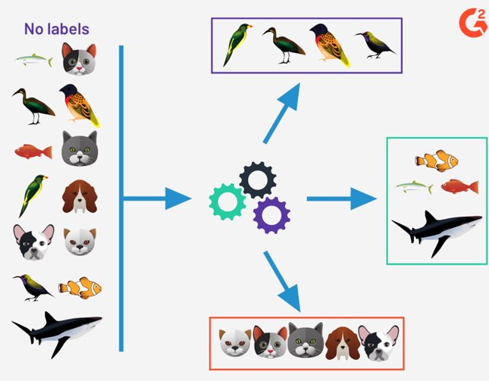
Let's understand Unsupervised Learning with an example
1. Unsupervised learning works by detecting the similarities and then grouping the similar points together and form clusters .
2. Whenever a new data point comes its features are matched with the clusters made and it allocated to the cluster with the most similarity .
Here , in this diagram three clusters are made based on the features , actions and functionality .

Slide 6
Clustering
What is Clustering?
Clustering can be considered the most important unsupervised learning problem.
Clustering is the task of dividing the population or data points into several groups such that data points in the same groups are more similar to other data points in the same group than those in other groups. It does it by finding some similar patterns in the unlabeled dataset such as shape, size, color, behavior, etc., and divides them as per the presence and absence of those similar patterns.
In simple words, the aim is to segregate groups with similar traits and assign them into clusters

Slide 7

Requirements of Clustering
The main requirements that a clustering algorithm should satisfy are:
Scalability
Ability to deal with different kinds of attributes
Discovery of clusters with attribute shape
High dimensionality
Ability to deal with noisy data
Interpretability

Slide 8

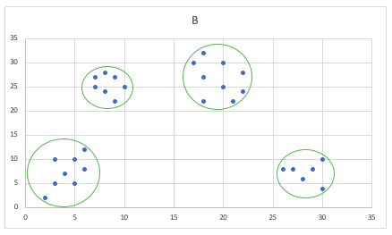
A | B
7 | 27
18 | 32
26 | 8
6 | 8
4 | 7
9 | 22
20 | 25
22 | 28
30 | 4
28 | 6
20 | 30
10 | 25
9 | 27
7 | 25
8 | 28
8 | 24
21 | 22
30 | 10
27 | 8
5 | 10
6 | 12
2 | 2
5 | 5
3 | 10
3 | 5
17 | 30
18 | 27
22 | 24
29 | 8
18 | 22
Clustering Example
In this example , all the data points are plotted and the points which are the most nearest or the data points whose distance the closest are grouped together and forms a cluster .

Slide 9
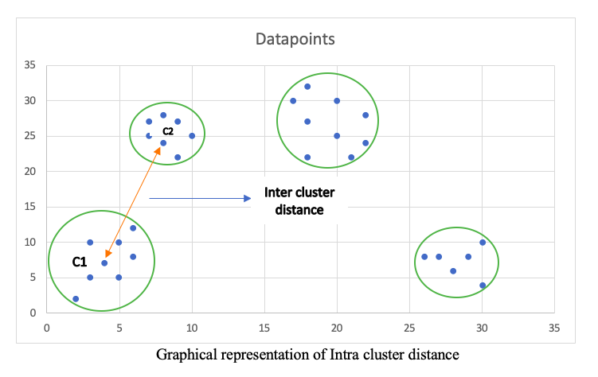
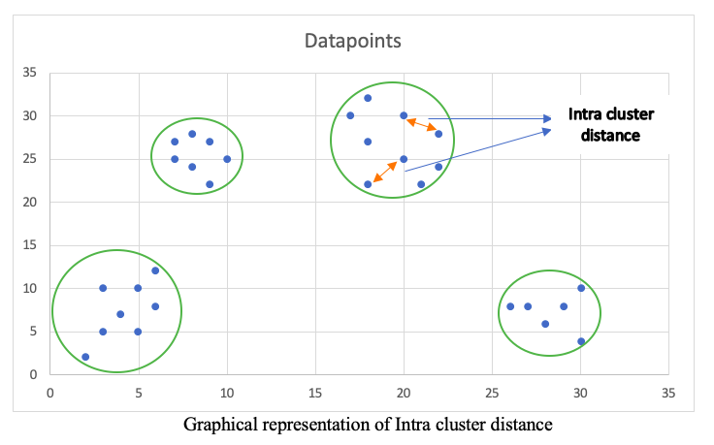
Inter-Cluster and Intra-Cluster Distances
Inter cluster is the distance between two objects/data points belonging to two different clusters .
Intra cluster is the distance between two objects/data points belonging to same cluster

Slide 10
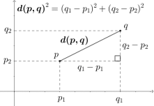
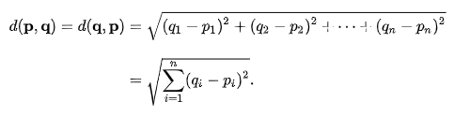
Euclidean distance
Euclidean distance or Euclidean metric is the "ordinary" straight-line distance between two points in Euclidean space. With this distance, Euclidean space becomes a metric space

Slide 11
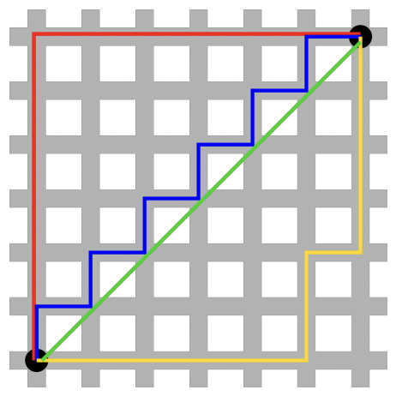
Manhattan distance
The distance between two points measured along axes at right angles. In a plane with p1 at (x1, y1) and p2 at (x2, y2), it is |x1 - x2| + |y1 - y2|
This is known as Manhattan distance because all paths from the bottom left to top rights of this idealized city have the same distance:

Slide 12

Minkowski distance
The Minkowski distance or Minkowski metric is a metric in a normed vector space which can be considered as a generalization of both the Euclidean distance and the Manhattan distance.
The Minkowski distance of order p (where p is an integer) between two points is defined as

Slide 13
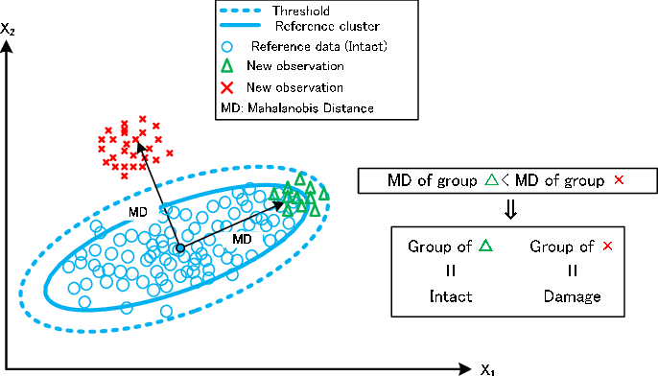


Mahalanobis Distance
The Mahalanobis distance of an observation $\vec{x }= {{(x}_{1},x_{2},x_{3…… }x_{n})}^{T}$ from a set of observations with $\vec{ }= {(_{1},_{2},_{3…… }_{n})}^{T}$ mean and covariance matrix S is defined as:

Slide 14
Types of Clustering Algorithms
K-Means Clustering
K-Means ++ Clustering
Hierarchical Clustering
DBSCAN (Density Based Clustering)
Most Important of all these is the K-Means Clustering.

Slide 15
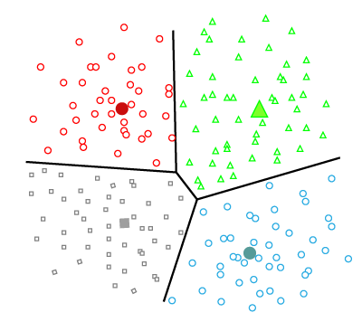
K-Means Clustering
K-Means attempts to classify data without having first been trained with labelled data.
In this type, the dataset is divided into a set of k groups, where K is used to define the number of pre-defined groups.
The cluster center is created in such a way that the distance between the data points of one cluster is minimum as compared to another cluster centroid.
Once the algorithm has been run and the groups are defined, any new data can be easily assigned to the most relevant group.

Slide 16

Steps for K-Means Algorithm

Slide 17
K-Means Clustering
Step 1 : Choose the number of clusters , k
Step 2 : Randomly select the centroid of each cluster
Step 3 : Find the Euclidean distance between each data instance and centroids of all the clusters.
Step 4 : Assign the data instances to the cluster of the centroid with nearest distance.
Step 5 : Calculate new centroid values based on the mean values of the coordinates of all the data instances from the corresponding cluster.
Step 6 : Repeat the 3 and 4 step till the model satisfies one of the below given condition :
The model halts creating and optimizing clusters when either:
The centroids have stabilized — there is no change in their values because the clustering has been successful.
The defined number of iterations has been achieved.

Slide 18
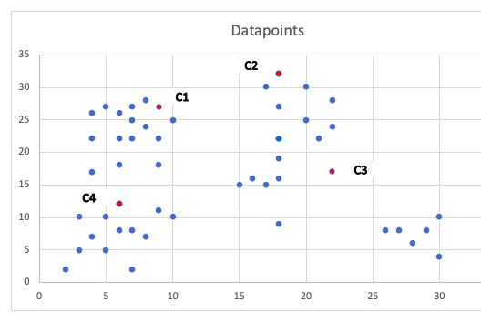
1.Select K random points as cluster center's called centroids. Let’s say we choose K = 4.

Slide 19
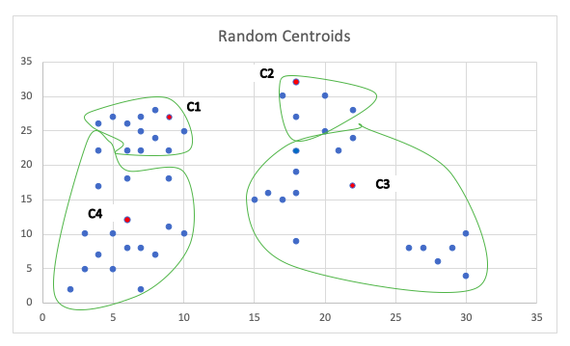
2. Assign each object to the group that has the closest centroid using the Distance formula .

Slide 20
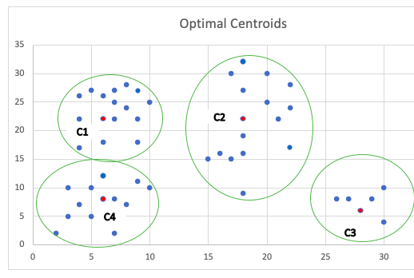
3. When all objects have been assigned, recalculate the positions of the K centroids. Repeat Steps 2 and 3 until the centroids no longer move.

Slide 21

Selecting the optimal K
The K-means algorithm aims to choose centroids that minimize the inertia i.e the sum of distances of all the points within a cluster from the centroid of that cluster.
This means the sum of intra cluster distance should be minimum.

Slide 22
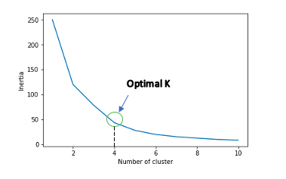
The Elbow Method
The Elbow Method is one of the most popular methods to determine this optimal value of k.
The number of cluster at which the inertia is minimum is choosen .

Slide 23
Thankyou

